Slide 1

The Link Between Data and Business Value
Notes:
My names is Tommy Lang. I’m on the advanced analytics team which formed about a year and half ago with the help of consultants from Mckinsey.
Before this team I was a desk auditor for personal income taxes.
This place is pretty much my first professional job out of college
In college I double majored in Accounting and Mathematics and I minored in IT
I’ve been at the DOR for 3 years and 3 months and I’m leaving in June to go back to school
Guees what I’m going back to school for?
In general DS is about leveraging insights from data
This could mean anything so I’ll some concrete examples of how DS is used
Feel free to ask if you have any questions during the presentation

Slide 2
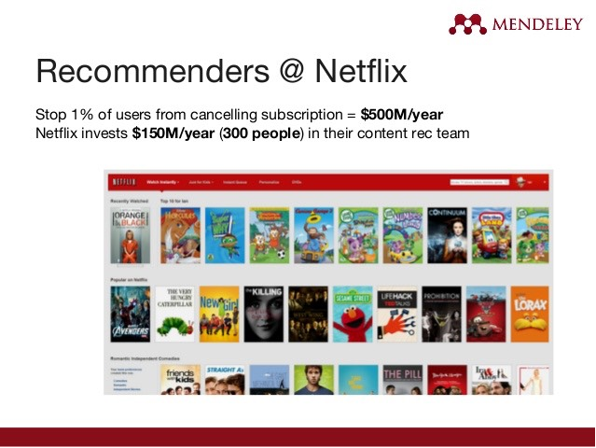
Examples of Data Science
Notes:
Recommendation engine at netflix is to predict what you want to watch so you continue to watch movies and won’t cancel subscription
In 2009 Netflix offered $1M to anyone that could improve their recommendation system by 10%
About 75% of what users watch is from recommendations
Other tech examples
Facebook tagging suggestion when pictures are uploaded
Virtual assistants: siri, alexa, bixby uses ML algorithms to interepret spoken language (NLP)
OCR
Machine learning is a big part of DS
This AA team has been using machine learning to solve business problems. Ex on next side

Slide 3
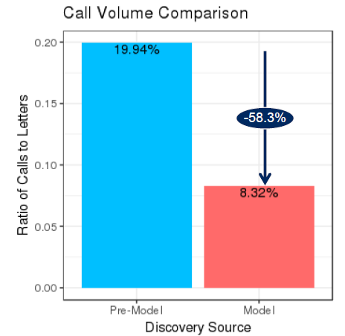
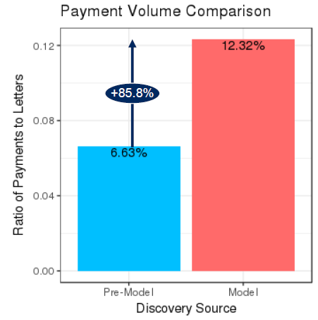
Automated Non-Filer Project
Notes:
IRS sends us data on informational tax forms like W2, 1099int, 1099b, 1099M on people linked to MA
For subset of these people we know they have income but not sure if they have MA filing requirement because
They could be non residents or have deductions and losses.
We sent letters randomly to these people to collect data on how they would respond
I built a model with this data and then we sent letters using the model and the above graphs show how it affected calls and payments
We also have a predictive model for small business underreporters
The idea behind that is that we use the model to estimate what a business should be reported for income and if
Its signifigantly different than what they actually report then we send them a letter that encourages them to report
The right amount if they didn’t do so. If they don’t comply then we audit them
This project is based on a similar one used by the IRS
Other state’s tax agencies also use machine learning for ID theft and collections ($83M increase in collections)

Slide 4
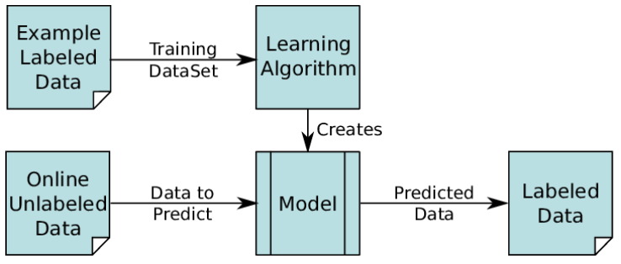
Supervised Machine Learning
Notes:
Previous two slides were a high level overview of how data science is used to provide business value
Now I’ll dig into a common method or tool used in data science called supervised machine learning
This is used for building predictive models
Machine learning is huge part of DS and supervised machine learning is a specific type of machine learning

Slide 5
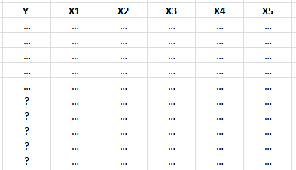
Structure of Data Set Used for Supervised ML
Notes:
There will be a lot more columns and a lot more rows. This is just a simplified example

Slide 6
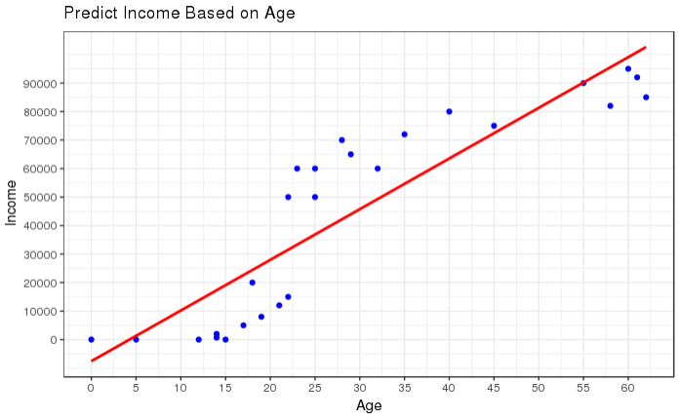
Predictive Model Toy Example
Model Formula:
Income = -7,571.445 + 1,777.487*Age
Model Performance:
RMSE = 1,6723.53
R Squared = 0.8141
Notes:
http://www.statisticshowto.com/probability-and-statistics/regression-analysis/find-a-linear-regression-equation/
Concrete example of supervised ML
RMSE: standard deviation of model errors
R Squared: measure of how close the actual values are to the fitted regression line. Percent of response variation that is explained by the model

Slide 7
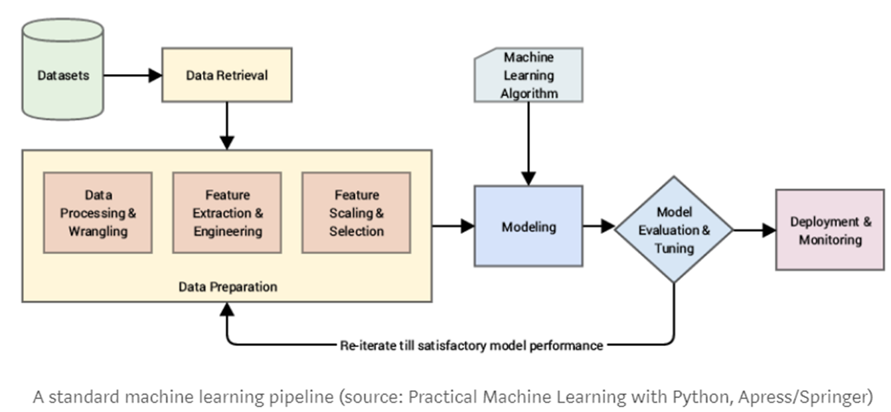
Predictive Modelling Project Workflow
Notes:
About 80% of the time and effort is spent on data preparation because models are garbage in garbage out

Slide 8
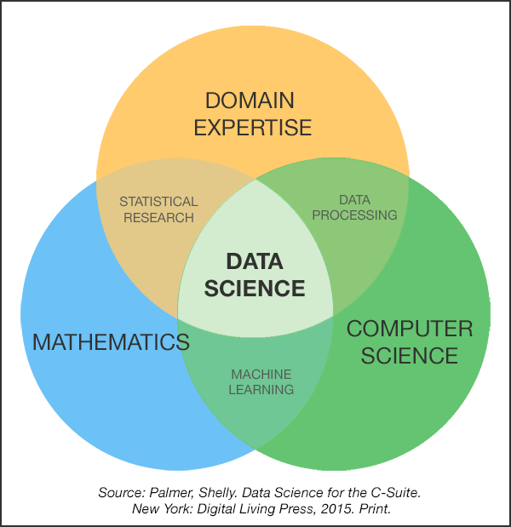
Data Science Skills
Notes:
I view Domain expertise as the most important
DS is really about the data and part of domain expertise understanding the data
Math and Comp sci is difficult technical fields but generally in DS you don’t need to prove any theroms or design complicated algos. You just need to apply
the theory or alogos that someone else has already created
Unless your on the really cutting edge side of DS

Slide 9
Hierarchy of Data Science Skills
Communication
Drives insights into action
Programming
Tools used to implement statistical concepts
Mathematics and Statistics
Concepts used to develop insights
Domain Knowledge and Expertise
Foundation of Data Science pipeline
Notes:
Need to explain the insight to the business and convince them to act on it

Slide 10
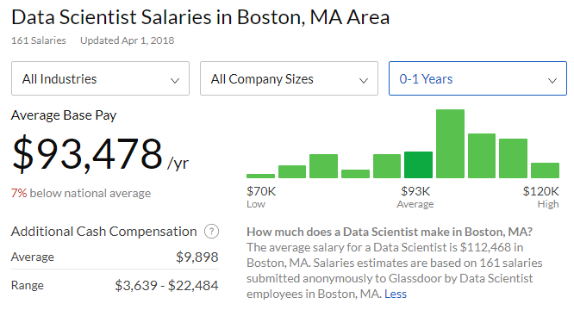
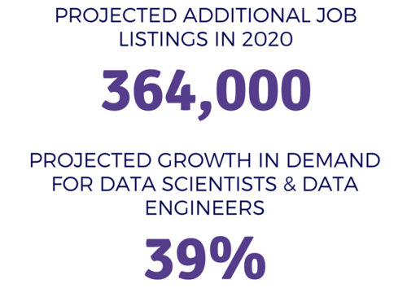
Data Scientist Job Outlook
Notes:
Very interesting work and also has great job outlook

Slide 11
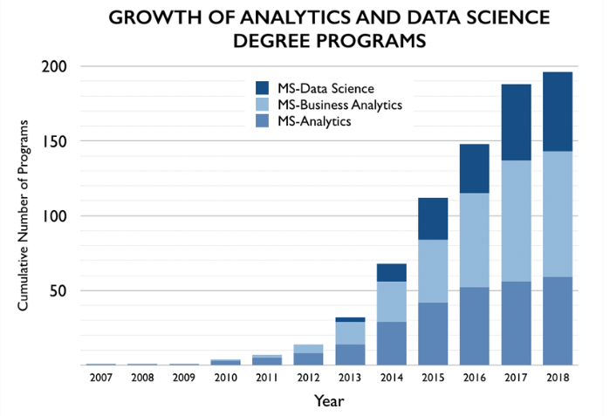
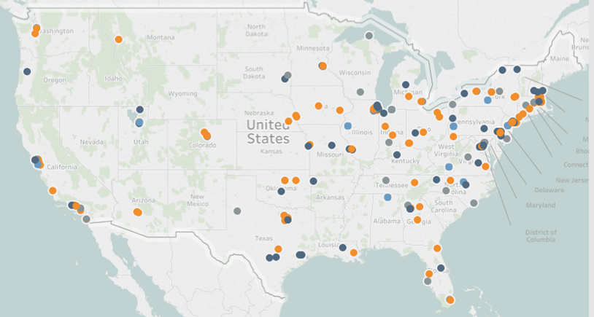
Data Science* Degree Programs
Notes:
Some of them are as little as 10 months
Some have close to 100% job placement rate after graduation
Usually only a handful of prequisites
I’m going to NC state
first program of its kind. (2007)
Consistently has 90% + placement rate by graduation with 95k average starting salary
10 months

Slide 12
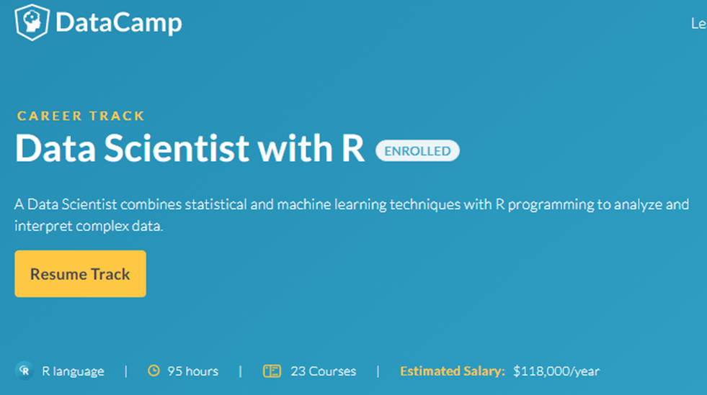
Free or Affordable Learning Resources
DataCamp.com
Kaggle.com
Coursera.com
Edx.com
Intro to Statistical Learning, (Hastie et al.)
Applied Predictive Modelling, (Kuhn et al.)
Notes:
Don’t need a degree you can learn almost everything for free or very low cost

